Slide 1
CN
UNIT II

Slide 2
THE DATA LINK LAYER DESIGN ISSUES
FUNCTIONS
Providing a well-defined service interface to the network layer.
Dealing with transmission errors.
Regulating the flow of data so that slow receivers are not swamped by fast senders –flow control.
The two main functions of the data link layer are:
Data Link Control (DLC): It deals with the design and procedures for communication b/w nodes: node-to-node communication.
Media Access Control (MAC): It explains how to share the link.

Slide 3
DATA LINK CONTROL (DLC): Data link control functions includes
Framing.
Error Control.
Flow Control.
FRAMING
The frame contains
Frame header
Payload field for holding packet
Frame trailer

Slide 4
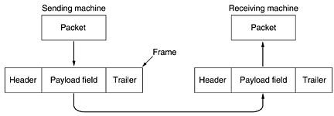
Services provided to the network layer
Transferring data from the network layer on the source machine to the network layer on the destination machine. The data link layer can be designed to offer various services.
The actual services offered can vary from system to system. Three reasonable possibilities that are commonly provided are

Slide 5
Unacknowledged connectionless service
Source machine sends independent frames to destination machine having destination machine acknowledge them
No logical connection
Acknowledged connectionless service
No logical connection
Each frame sent is individually acknowledged
Acknowledged connection-oriented service
DLL guarantees that...
Each frame is received
Each frame is received exactly once
Each frame is received in the right order

Slide 6
FRAMING
There are four methods:
Character count.
Flag bytes with byte stuffing.
Starting and ending flags, with bit stuffing.
Physical layer coding violations.

Slide 7
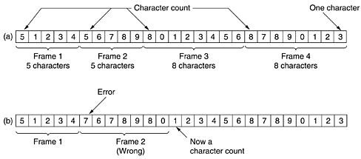
Character count:
Figure 3-4. A character stream. (a) Without errors. (b) With one error.

Slide 8
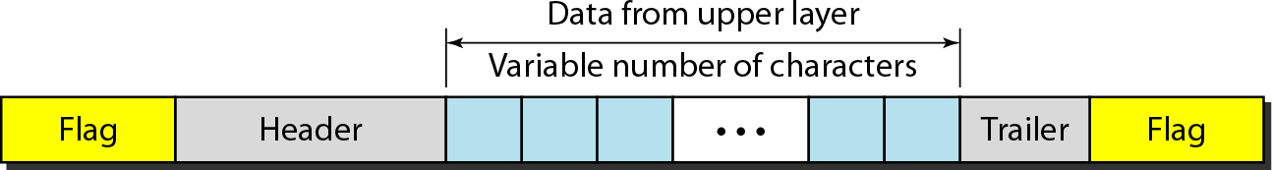
Flag bytes with byte stuffing:
Advantage:
Simple framing method.
Character-oriented framing was popular when only text was exchanged by the data Link layers.
The flag could be selected to be any character not used for text communication.

Slide 9
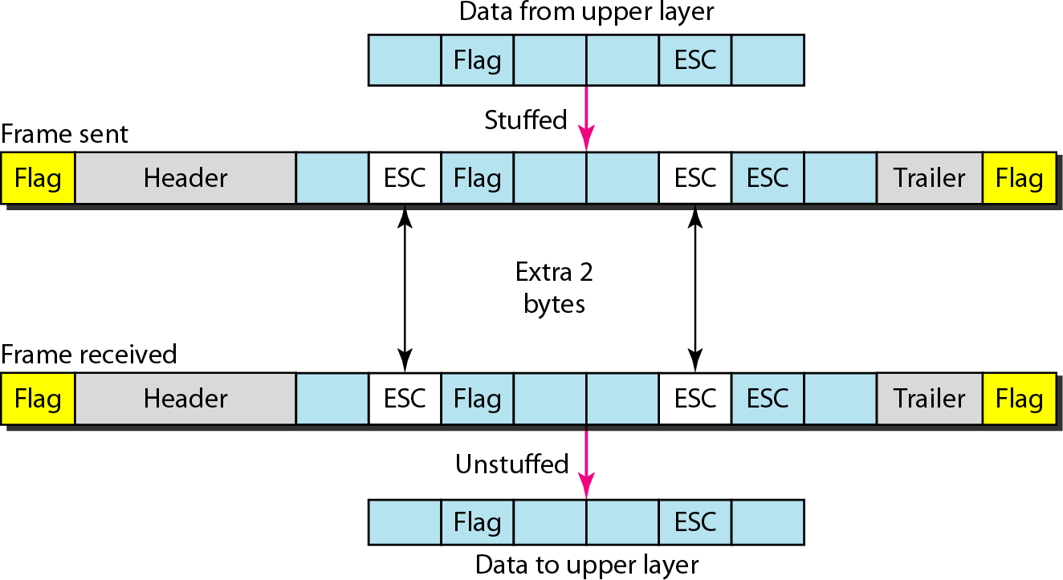
Starting and ending character with byte stuffing
Figure : Byte stuffing and unstuffing

Slide 10
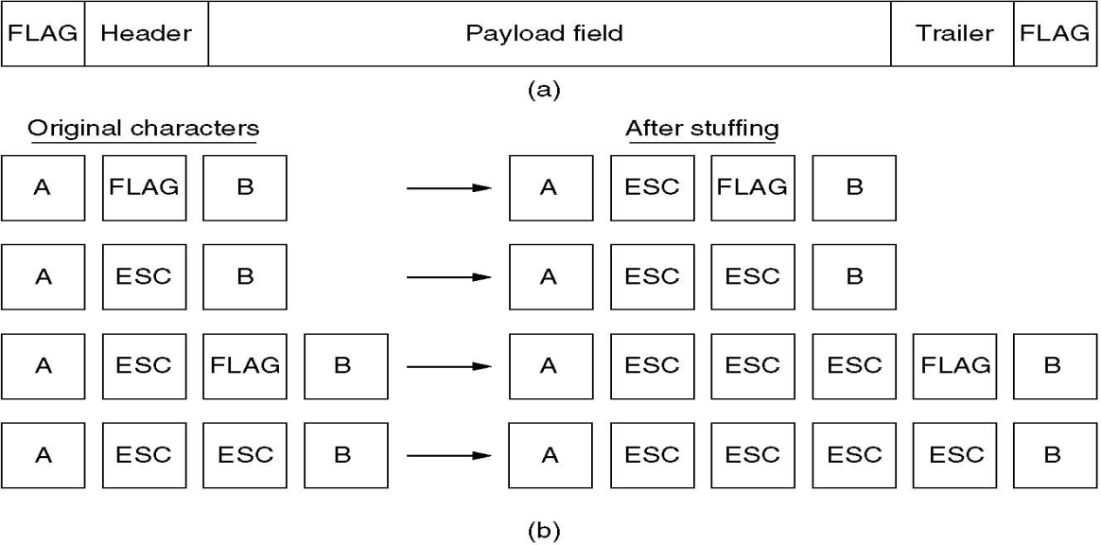
Fig: Framing with byte stuffing

Slide 11
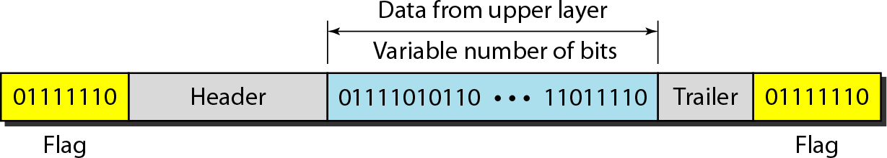
Bit-Oriented framing approach
Bit stuffing is the process of adding one extra 0 whenever five consecutive 1’s follow a 0 in the data, so that the receiver does not mistake the pattern 0111110 for a flag.
Most protocols use a special 8-bit pattern flag 01111110 as the delimiter to define the beginning and the end of the frame, as shown in Figure below

Slide 12
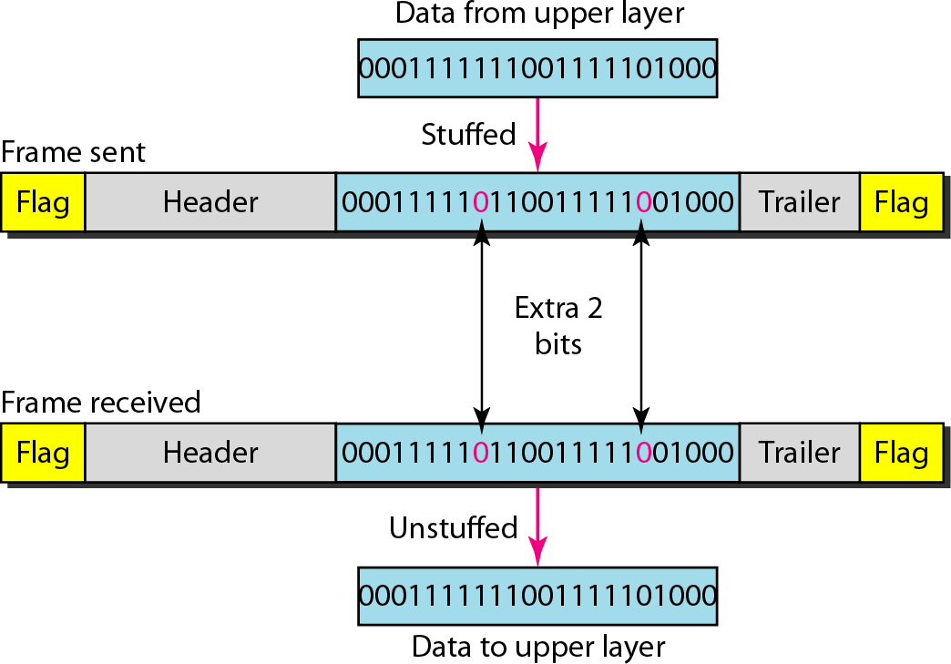
Bit stuffing is the process of adding one extra 0 whenever five consecutive 1s follow a 0 in the data, so that the receiver does not mistake the pattern 0111110 for a flag.

Slide 13
ERROR CONTROL
How do we make sure that all frames are eventually delivered to the network layer at the destination and in the proper order?
Provide sender with some acknowledgement about what is happening with the receiver
Sender could wait for acknowledgement
TYPES OF ERRORS
Single bit error: Only one bit gets corrupted. Common in Parallel transmission.
Burst error: More than one bit gets corrupted very common in serial transmission of data occurs when the duration of noise is longer than the duration of one bit.

Slide 14
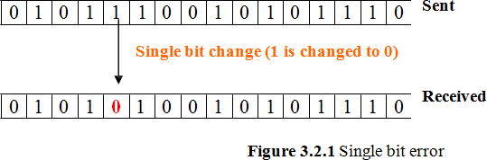
Single bit error:The term single-bit error means that only one bit of given data unit (such as a byte, character, or data unit) is changed from 1 to 0 or from 0 to 1.

Slide 15
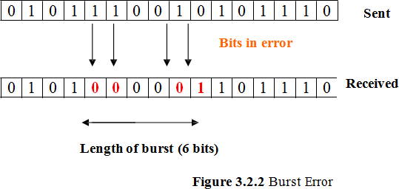
Burst error:
More than one bit gets corrupted very common in serial transmission of data occurs when the duration of noise is longer than the duration of one bit.
The noise affects data; it affects a set of bits.

Slide 16
ERROR DETECTION TECHNIQUES
Cyclic redundancy check (CRC)
Unlike checksum scheme, which is based on addition, CRC is based on binary division.
In CRC, a sequence of redundant bits, called cyclic redundancy check bits, are appended to the end of data unit so that the resulting data unit becomes exactly divisible by a second, predetermined binary number.
At the destination, the incoming data unit is divided by the same number. If at this step there is no remainder, the data unit is assumed to be correct and is therefore accepted.

Slide 17
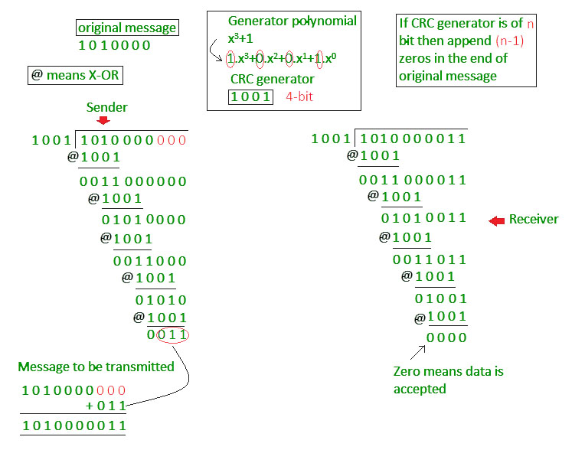
CRC

Slide 18
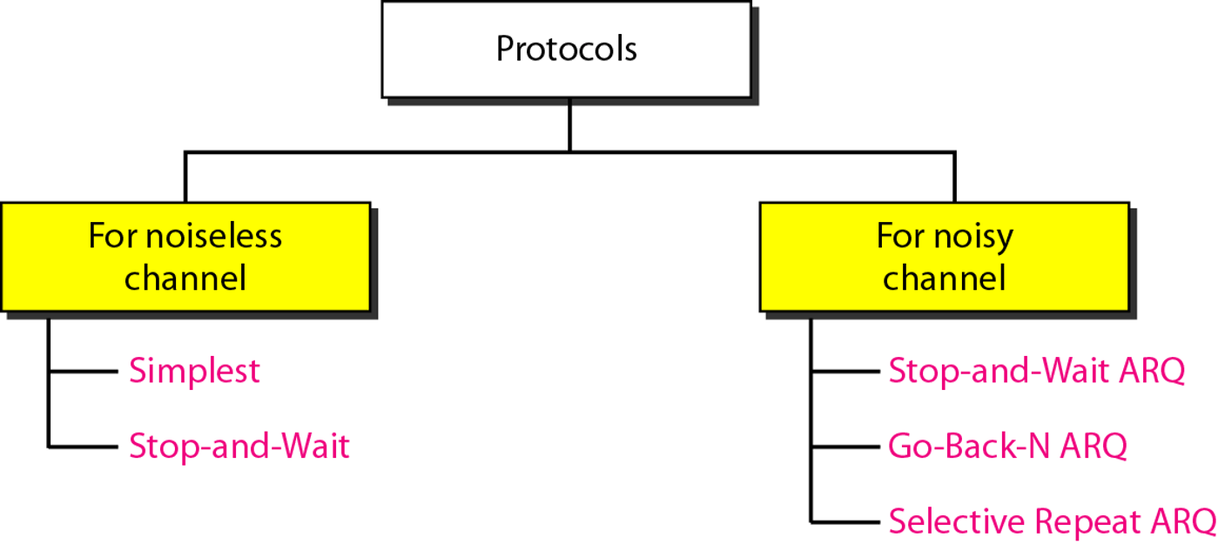
ELEMENTARY DATA LINK LAYER PROTOCOLS
PROTOCOLS
The protocols are normally implemented in software by using one of the common programming languages.

Slide 19
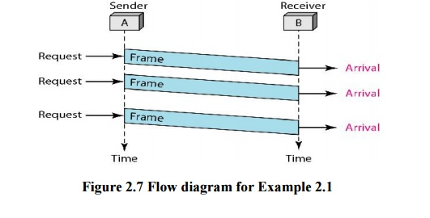
NOISELESS CHANNELS
Simplest Protocol
It has no flow or error control. It is a unidirectional protocol in which data frames are traveling in only one direction-from the sender to receiver.
The data link layer of the receiver immediately removes the header from the frame and hands the data packet to its network layer, which can also accept the packet immediately

Slide 20
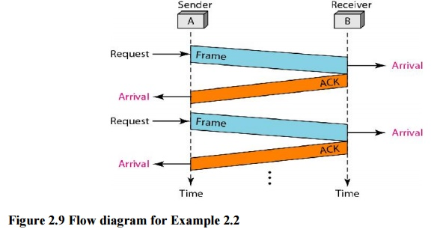
Stop-and-Wait Protocol
If data frames arrive at the receiver site faster than they can be processed, the frames must be stored until their use.
In Stop-and-Wait Protocol the sender sends one frame, stops until it receives confirmation from the receiver (okay to go ahead), and then sends the next frame.

Slide 21
Noisy Channels:
1. Stop-and-Wait Automatic Repeat Request
The Stop-and-Wait Automatic Repeat Request (Stop-and-Wait ARQ), adds a simple error control mechanism to the Stop-and-Wait Protocol.
To detect and correct corrupted frames, we need to add redundancy bits to our data frame.
When the frame arrives at the receiver site, it is checked and if it is corrupted, it is silently discarded.
The detection of errors in this protocol is manifested by the silence of the receiver.

Slide 22
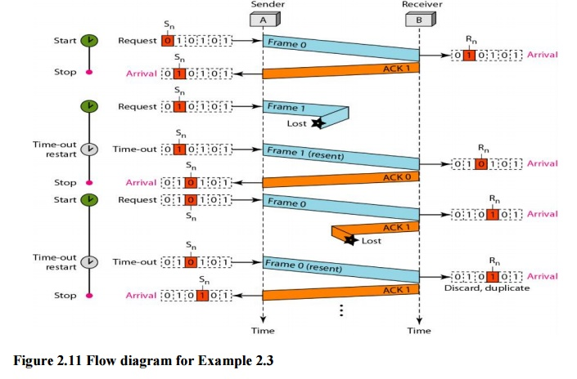
Stop-and-Wait Automatic Repeat Request

Slide 23
Go-Back-N Automatic Repeat Request
a data link layer protocol that uses a sliding window mechanism for reliable data transmission.
It allows a sender to transmit multiple frames (up to a window size 'N') without waiting for acknowledgements.
If a frame is lost or times out, the sender retransmits that frame and all subsequent frames within the window.

Slide 24
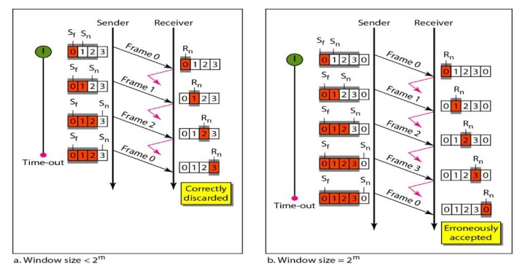
Go-Back-N Automatic Repeat Request

Slide 25
Sliding Window
The sliding window is an abstract concept that defines the range of sequence numbers that is the concern of the sender and receiver.
In other words, the sender and receiver need to deal with only part of the possible sequence numbers.
The range which is the concern of the sender is called the send sliding window.
The range that is the concern of the receiver is called the receive sliding window.

Slide 26
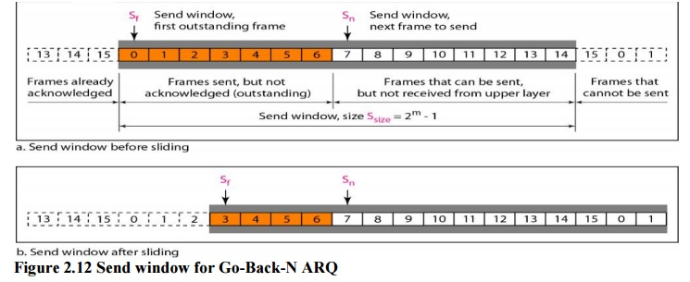
Sliding Window

Slide 27
Selective Repeat Automatic Repeat Request
Go-Back-N ARQ simplifies the process at the receiver site.
The receiver keeps track of only one variable, and there is no need to buffer out-of-order frames; they are simply discarded.
However, this protocol is very inefficient for a noisy link.
In a noisy link a frame has a higher probability of damage, which means the resending of multiple frames.
This resending uses up the bandwidth and slows down the transmission.

Slide 28
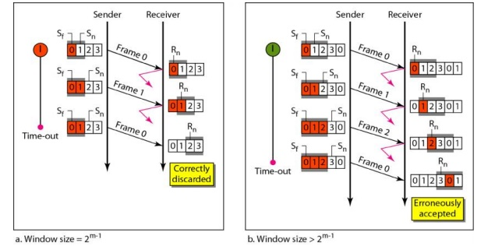
Design of Selective Repeat ARQ

Slide 29
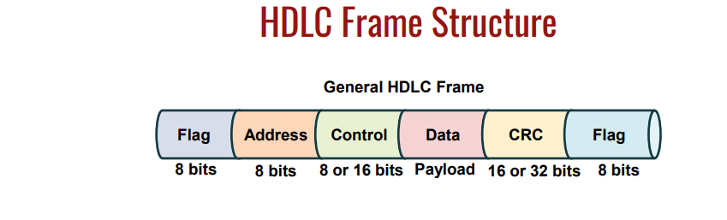
High-level Data Link Control
HDLC is a bit - oriented protocol where each frame contains up to six fields. The structure varies according to the type of frame. The fields of a HDLC frame are −
Flag − It is an 8-bit sequence that marks the beginning and the end of the frame. The bit pattern of the flag is 01111110.

Slide 30
Address − It contains the address of the receiver. If the frame is sent by the primary station, it contains the address(es) of the secondary station(s). If it is sent by the secondary station, it contains the address of the primary station. The address field may be from 1 byte to several bytes.
Control − It is 1 or 2 bytes containing flow and error control information.
Payload − This carries the data from the network layer. Its length may vary from one network to another.
FCS − It is a 2 byte or 4 bytes frame check sequence for error detection. The standard code used is CRC (cyclic redundancy code)

Slide 31
Three classes of frames are used –
• Information frames (I-Frames) – Carry the actual data. Transport user data from the network layer. In addition, they can also include flow and error control information piggybacked on data
• Supervisory frames (S-Frames) – Used for error and flow control. They contain, send and receive sequence numbers
• Unnumbered frames (U-Frames) – Used for various miscellaneous purposes, including link management

